Slide 1
Permanent Maxillary Lateral Incisor
RUNGTA COLLEGE OF DENTAL SCIENCES & RESEARCH
DEPARTMENT OF ORAL PATHOLOGY

Slide 2
Specific learning Objectives
Core areas* | Domain ** | Category #
Introduction | COGNITIVE | MUST KNOW
Tooth numbering/notation Functions Chronology Dimensions Aspects ( 5 - labial, palatal, mesial, distal, incisal ) | COGNITIVE COGNITIVE COGNITIVE COGNITIVE COGNITIVE COGNITIVE | MUST KNOW MUST KNOW MUST KNOW MUST KNOW MUST KNOW

Slide 3
Contents
Introduction
Tooth numbering/notation (All 3 systems)
Functions
Chronology
Dimensions
Aspects ( 5 - labial, palatal, mesial, distal, incisal )

Slide 4
Question on any of the tooth ( for 10 marks)
Introduction
Tooth numbering/notation (All 3 systems)
Functions
Chronology
Dimensions
Aspects ( 5 - labial, palatal, mesial, distal, incisal )
1
1
1
1
1
5
10

Slide 5
2 in number (Right & Left) Mesial side : Maxillary central incisor Distal side : Maxillary canine Maxillary central incisor and lateral are similar in anatomy and complement each other in function
Introduction

Slide 6
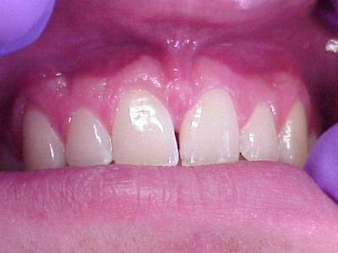
Overall dimensions
Maxillary central incisor is bigger and lateral incisor smaller
Maxillary Lateral incisor < Maxillary Central incisor
Smaller than CI in all dimensions except root length

Slide 7
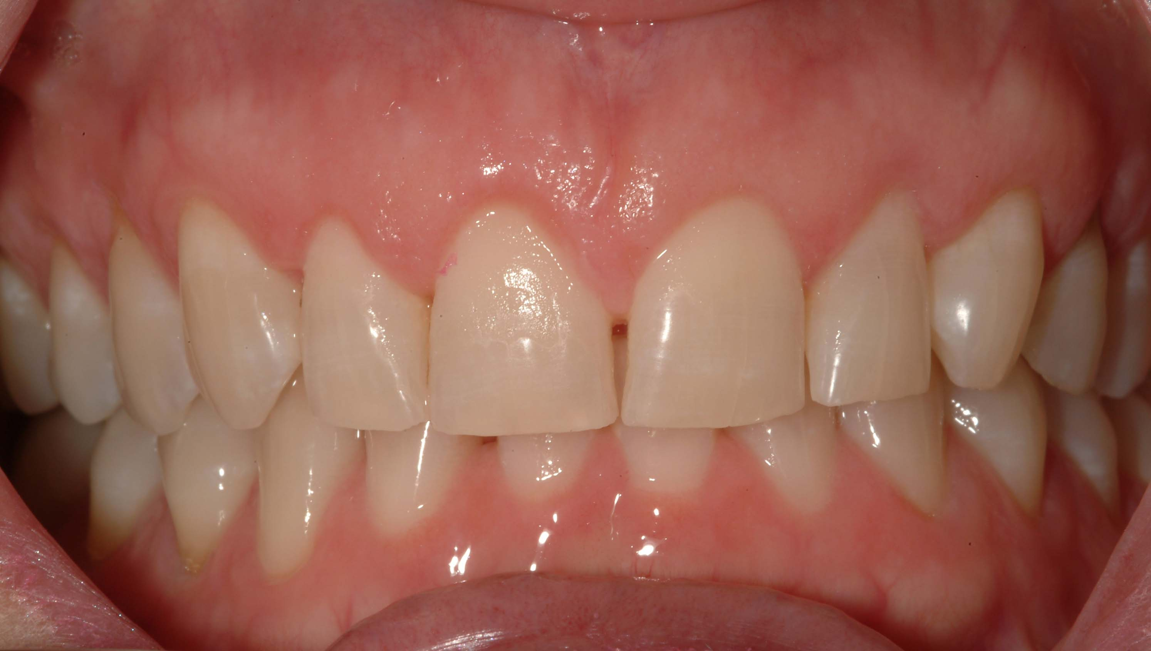
Incisors :- They are the “cutting teeth”
Sharp incisal edge
Central & Lateral

Slide 8
Function :
- The incisors are shearing or cutting teeth.
(Their major function is to cut or bite food, slicing them using the sharp edge)
- They provide aesthetic appeal to the face
- They support the lips which rest on them
- They help in speech (pronunciation of certain alphabets)
- Help in guiding the jaw when mouth is closed

Slide 9
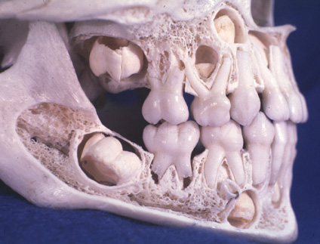
Age of Eruption
Deciduous : erupts between the age of 9 – 12 months.
Permanent : erupts between the age of 8-9 yrs

Slide 10
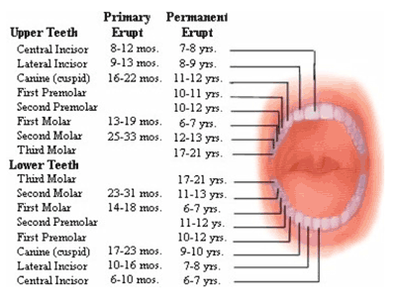

Slide 11
Tooth notation
 | Right Lateral | Left Lateral
Universal | 7 | 10
Zigmondy | 2 | 2
FDI | 12 | 22

Slide 12
Chronology
Maxillary Lateral Incisor
Initial calcification (First evidence of calcification) | 1 year
Enamel Completion (crown completion) | 4-5 years
Eruption | 8-9 years
Completion of root | 11 years

Slide 13
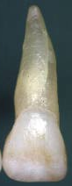
Dimensions
Maxillary Lateral Incisor
Cervicoincisal length of crown | 9.0 mm
Length of root | 13.0 mm
Mesiodistal diameter of crown | 6.5 mm
Mesiodistal diameter of crown at cervix | 5.0 mm
Labiolingual diameter of crown | 6.0 mm
Labiolingual diameter of crown at cervix | 5.0 mm
Curvature of cervical line mesially | 3.0 mm
Curvature of cervical line distally | 2.0 mm
10.5
13
8.5
7
7
6
3.5
2.5

Slide 14
Maxillary Lateral Incisor
Cervicoincisal length of crown | 9.0 mm
Length of root | 13.0 mm
Mesiodistal diameter of crown | 6.5 mm
Mesiodistal diameter of crown at cervix | 5.0 mm
Labiolingual diameter of crown | 6.0 mm
Labiolingual diameter of crown at cervix | 5.0 mm
Curvature of cervical line mesially | 3.0 mm
Curvature of cervical line distally | 2.0 mm

Slide 15
Maxillary Lateral Incisor
Cervicoincisal length of crown | 9.0 mm
Length of root | 13.0 mm
Mesiodistal diameter of crown | 6.5 mm
Mesiodistal diameter of crown at cervix | 5.0 mm
Labiolingual diameter of crown | 6.0 mm
Labiolingual diameter of crown at cervix | 5.0 mm
Curvature of cervical line mesially | 3.0 mm
Curvature of cervical line distally | 2.0 mm

Slide 17
Labial aspect
Geometric shape : Trapezoidal
Crown appears smooth & concave
Tooth is longer cervicoincisally than it is wider mesiodistally
Newly erupted incisor shows 3 elevations – “mamelons”

Slide 18
Labial aspect
The mesial margin is slightly convex and meets the incisal edge to form a curvature. (slightly rounded when compared to CI)
The distal margin is shorter, convex and more rounded.
Distal margin shorter & rounded
Mesial margin slightly convex

Slide 19
The distoincisal angle is more rounded than the mesioincisal angle.
Distal margin is more rounded than CI
Distoincisal angle more rounded
Mesioincisal angle is SLIGHTLY ROUNDED
Incisal ridge is curved towards the distal margin

Slide 20
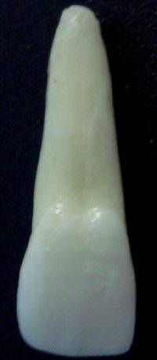
Mesial margin is slightly rounded than CI
Distal margin is more rounded than CI

Slide 21
The labial surface is marked by two developmental groove and has more convexity in cervical third when compared to CI.
More Convexity in cervical third
a
b
a & b: Developmental depressions
1,2 & 3: Lobes (4th lobe not visible)

Slide 23
Lingual aspect (or) Palatal aspect
General shape : Trapezoidal
Topography : Scoop like form of the crown
Presence of lingual convergence
Crown tapers lingually (labial surface is broader than lingual)
Most prominent feature : Cingulum
The root appears conical & ends in blunt apex

Slide 24
There is a broad depression (concavity) in the central portion called the lingual fossa - (more deeper when compared to CI)
A well developed convexity - cingulum.
Cingulum
Marginal ridges
Lingual fossa
Lingual ridge

Slide 25
The cervical line on labial and lingual surface is convex apically.
Cervical line convex
Labial aspect
Lingual aspect

Slide 26
The lingual fossa is bordered by mesial and distal marginal ridges on the sides
The MMR & DMR are more prominent when compared to CI
Marginal ridges

Slide 27
Marginal ridges & cingulum – more prominent
Root is narrower
MMR – longer & straight than DMR (more rounded)
Prominent cingulum
Deeper lingual fossa
Much Prominent marginal ridges

Slide 29
MESIAL ASPECT
Geometric shape :
Triangular or Wedge shape
Base : cervix
Apex : incisal ridge

Slide 30
Mesial Aspect
This aspect is similar to that of Central incisor except the root appears longer (The crown is shorter , the root is relatively longer)
The crown labiolingually is narrower than the maxillary central incisor
The curvature of cervical line is less than the maxillary central incisor
Root appears as tapered cone, & a line bisecting the root, bisects the incisal ridge of the crown

Slide 31
Mesial aspect
Labial outline : the labial margin is convex & curves smoothly
Lingual outline : is ‘S’ shaped, being convex near cingulum and concave in the middle
Convex near cingulum
Labial margin convex
Concave in the middle

Slide 32
Mesial aspect
Mesial contact area – at junction of middle & incisal 3rd
The incisal edge is rounded

Slide 33
Mesial curvature of cervical line
The average depth of cervical line is 3 mm
The cervical line on the mesial curves incisally
Cervical line

Slide 35
DISTAL ASPECT
The width of the crown distally appears thicker than mesial aspect.
Presence of developmental groove distally on the crown extending on the root

Slide 36
Distal aspect
Labial outline : the labial margin is convex & curves smoothly
Lingual outline : is ‘S’ shaped, being convex near cingulum and concave in the middle
Convex near cingulum
Labial margin convex
Concave in the middle

Slide 37
Only 4 differences (compared to mesial aspect)
The crown appears thicker than the mesial aspect
Presence of developmental groove on distal aspect of root
The curvature of cervical line is less than that in the mesial aspect
Contact area is more cervically placed (at centre of middle 3rd)

Slide 39
Incisal aspect
Geometrical shape : Oval to triangular
Crown profile is almost bilaterally symmetrical
The crown appears to taper from the labial aspect towards the cingulum.(lingual convergence)
Dominated by the presence of cingulum.
Labiolingual dimension is greater than mesiodistal dimension

Slide 41
Root
Number : Single root
Size : almost 1.5 times longer than crown
Root length is greater in proportion to crown length when compared to CI
Presence of Distal tipping of root tip
The root tapers from the cervical line to the apex giving it a conical shape
Straight conical blunt root

Slide 42
Root
Apex is blunt
Presence of Distal curvature
Lingual convergence of root is seen

Slide 43
SUMMARY
The maxillary lateral incisor is a human tooth in the front upper jaw, or maxilla, and is usually the most visible of all teeth in the mouth. It is located distal (closer to the midline of the face) to the maxillary central incisor. As with all incisors, their function is for shearing or cutting food during mastication (chewing). There is typically a single cusp on each tooth, called an incisal ridge or incisal edge. Formation of these teeth begins at 14 weeks in utero for the deciduous (baby) set and 3–4 months of age for the permanent set

Slide 44
Take home message
The maxillary lateral incisor is a human tooth in the front upper jaw, or maxilla, and is usually the most visible of all teeth in the mouth. It is located distal (closer to the midline of the face) to the maxillary central incisor.

Slide 45
References
Nelson, Stanley J. (2014-11-25). Wheeler's dental anatomy, physiology, and occlusion. ISBN 9780323263238.Philadelphia W.B. Saunders ;2002
Richard Tencate , Oral Histology development ,structure and function . 5th Edition ,1998
Carranza F.A., Michael G. Newman . Clinical periodontology 8,9,10th edition

Slide 46
Frequentely Asked Questions
Describe various aspects of Permanent Maxillary lateral incisor in detail
Morphology of Permanent Maxillary lateral incisor
Differences beween Labial and Lingual aspect of Permanent Maxillary lateral incisor
Draw well labelled diagram of Permanent Maxillary lateral incisor

Slide 47
THANKYOU

